Slide 1
EQ:2a & 2b
The Cumberland Road

Slide 2
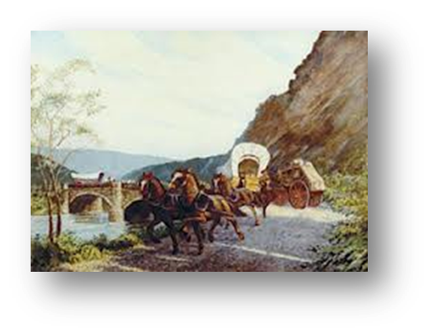
SA:2a
How did the Cumberland road help the economy?
The Cumberland Road increased the nation’s economy by allowing trade among states. As the nation grew, it was used to transport goods from the western states, Ohio, Illinois, Indiana to the eastern seaboard and to harbors along it to be traded and sold to other countries.
The Cumberland Road was also meant as a trade route between states and later a way of travel to the beginning of the Transcontinental Railroad on the eastern side of the nation.

Slide 3
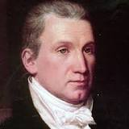
James Monroe
James Monroe had been trying to get a road like the Cumberland Road authorized far before the time that the people wanted it. He was ignored because congress thought that the Constitution already gave the government permission to do so. It turned out that it didn’t day that they couldn’t, but it didn’t say that they could either. They passed a bill giving the government the right to run federal roads, and the Cumberland Road began.

Slide 4
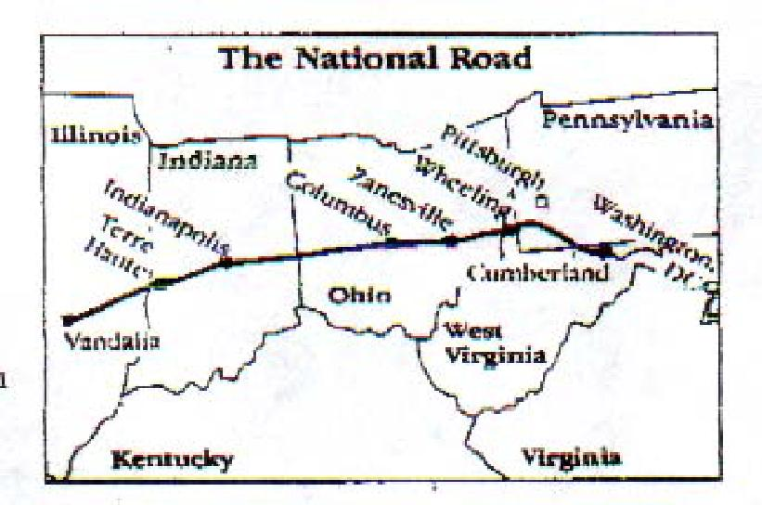
Power of the States
Nearing the end of its completion, President James Monroe urged Congress to make sections of the road run by the states those sections were in.
It was never finished by the government, but when it was passed on to the states, they built the road up to what we know today.

Slide 5
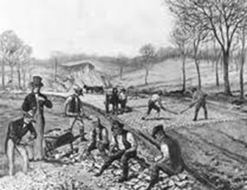
SA:2b
Where did the Cumberland Road travel and what was it’s purpose?
The Cumberland Road ran from Cumberland, Maryland, to Wheeling, West Virginia. In 1825, the road was expanded from Wheeling, to Zanesville, Ohio.
The Cumberland Road actually became the National Road because it was the longest dirt road that the United States had at the time. After they were able to build a national road they decided to repair the dirt road and then improve it by laying stone down over it so it would be harder to erode away.

