Slide 1
eq:2c & 2d
The Erie Canal

Slide 2
EQ:2c
How did the Erie Canal help the economy?
The effects the Erie Canal had on the country's economy were dramatic as well as instantaneous.
Trade along the canal exploded as the cost to ship goods were sharply dropped.
New York was the sea port at the end of the Erie Canal and it became the busiest sea port in America.
New York Shipped tonnages greater that Boston, Baltimore, and New Orleans combined!

Slide 3
Why
Freight rates went from $100 a ton by road travel to as low as $10 a ton by the Erie Canal.
Here are some of the statistics that have been figured after the Canal was built.
In 1829 3,640 bushels of wheat were transported down the Canal.
By 1837, over 500,000 bushels of wheat were transported to New York.
By 1841, over one million bushels wheat were transported down to New York.
In nine years, the canal tolls completely paid off the cost to construct it.

Slide 4
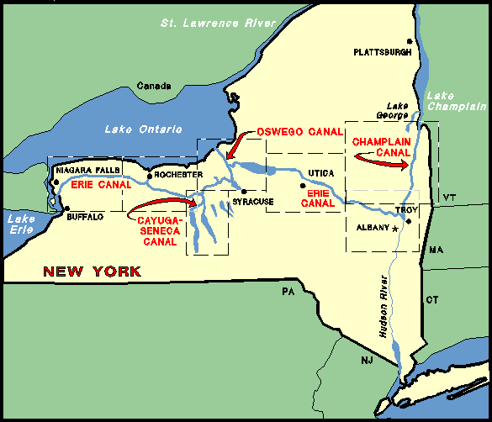
Why
With the exception of the cities Binghamton and Elmira, every major city in the state of New York falls along the Erie Canal.
From New York City to Albany, Schenectady, Utica, Syracuse, Rochester, Buffalo all connect to the Erie Canal.
Almost 80% of upstate New York’s population lives within twenty-five miles of the Canal.

Slide 5
EQ:2d
Where did it flow and what was its purpose?
The Erie Canal connects to the Hudson River which goes all the way down to New York and the Atlantic Ocean
It flowed from Buffalo, NY, to Albany, NY.
At Albany it connected to the Hudson river where it turns sharply to the South.
The Canal’s dimensions are 363 miles long, 40 feet wide, and 4 feet deep when it was completed on 1825

Slide 6
Locks
The way the Canal worked was by using locks.
http://www.eriecanal.org/locks.html
The Erie Canal was completed with 83 locks.
This resulted in a 568 feet rise from the Hudson river to Lake Erie.

Slide 7
Reconstruction
In 1836, the Erie Canal was enlarged due to greater need for more tonnages.
The current tonnage limit on the Erie Canal was 30 tons of freight.
Finished in 1862, the enlarged Canal’s dimensions was 70 wide and 7 feet deep. This canal could carry up to 240 tons of freight.
The canal was reconstructed again in 1903 and finished in 1918. It is 12-14 feet deep and is 120-200 feet wide.
This resulted as the final canal and contained 57 locks.
This canal still remains today, but for recreational boats rather than cargo boats

Slide 8
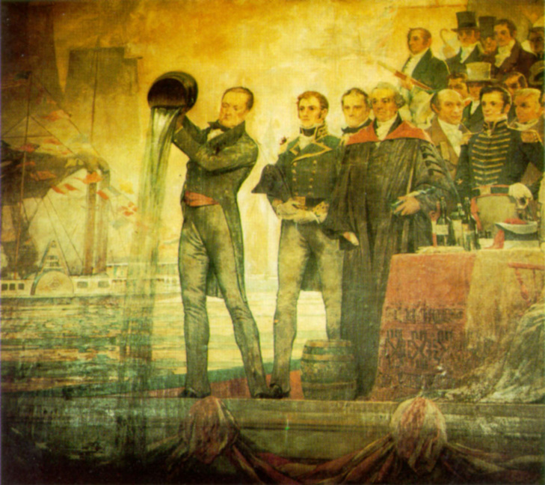
“Clinton’s Ditch”
Governor Dewitt Clinton, (mayor at the time) made the first move to make the Canal that would make him popular among the people of New York.
“The city will, in the course of time, become the granary of the world, the emporium of commerce, the seat of manufactures, the focus of great moneyed operations.” Dewitt Clinton, Mayor of NYC
The Wedding of the Waters, Depicted by C.Y. Turner

